Slide 1

CMSC 137
Data Communications and Networking
Lecture Module
16 – Wired LAN: Ethernet

Slide 2
Module 16: Wired LAN: Ethernet
Rozano S. Maniaol
Lecturer

Slide 3
Introduction
Recall: TCP/IP protocol suite does not define any protocol for the data link or the physical layer, it accepts any protocol at these layers that can provide services to the network layer
Data link and physical layer are actually the territory of the local and wide area network
Several types of LANs were used in the the 1980s and 1990s and used the media access method to solve the problem of sharing the media
  Ethernet used CSMA/CD
  Token ring, token bus, FDDI used token passing approach

Slide 4
Introduction
Project 802 – to set the standards to enable intercommunication among equipment from a variety of manufacturers (1985)
Does not seek to replace OSI but to provide a way of specifying functions of the physical layer and data link layer of major LAN protocols
Adopted by ANSI and ISO (8802)
Data link layer divided into logical link control (LLC) and media access control (MAC)

Slide 5
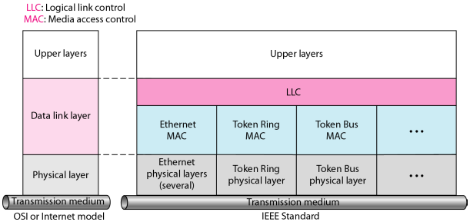
IEEE Standards for LANs

Slide 6
Ethernet Evolution

Slide 7
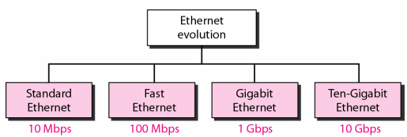
Ethernet
Original Ethernet was created in 1976 by Robert Metcalfe and David Boggs at Xerox's Palo Alto Research Center (PARC)
  Standard Ethernet (10 Mbps)
  Fast Ethernet (100 Mbps)
  Gigabit Ethernet (1 Gbps)
  Ten-Gigabit Ethernet (10 Gbps)

Slide 8
Standard Ethernet
802.3
Connectionless and unreliable service
  Each frame is independent of the previous or next frame
  Has no connection establishment or connection termination phases
  If a frame is corrupted during transmission and the receiver finds about the corruption (CRC-32), the receiver drops the frame silently
  It is the duty of the high-level protocol to find out about it

Slide 9
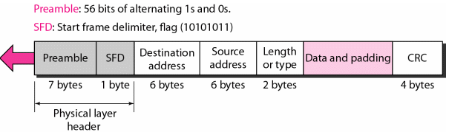
Standard Ethernet
Preamble – 7 bytes (56 bits) of alternating 0s and 1s, for synchronization
Start of frame delimiter (SFD) – 10101011, signals the beginning of the frame
Destination address (DA) – 6 bytes
Source address (SA) – 6 bytes
Length or type – type of upper layer protocol or number of bytes in data field
Data – carries data encapsulated from the upper-layer protocols, minimum of 46 and maximum of 1500 bytes
CRC – CRC-32 for error detection

Slide 10
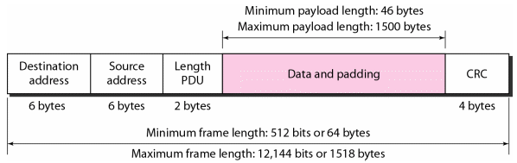
Standard Ethernet
Has minimum and maximum frame length
Padding is added if minimum is not met
Maximum length: reduce buffer size, prevent monopoly of link

Slide 11
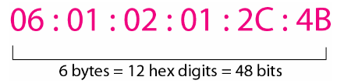

Standard Ethernet
Network Interface Card (NIC) has a 6-byte (48 bits) physical address written in hex with colon between bytes
Destination address can be unicast, multicast, or broadcast; least significant bit of first byte determines the type; broadcast has all 1s

Slide 12
Standard Ethernet
Examples
  4A:30:10:21:10:1A → unicast (A is 1010)
  47:20:1B:2E:08:EE → multicast (7 is 0111)
  FF:FF:FF:FF:FF:FF → broadcast
Address is sent left to right: 47:20:1B:2E:08:EE
  ← 11100010 00000100 11011000 .. and so on

Slide 13
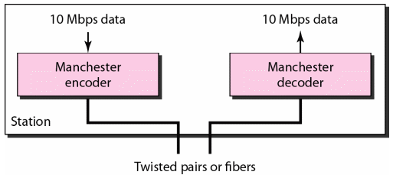
Standard Ethernet
Uses 1-persistent CSMA/CD
Physical Layer implementations
  Uses digital signaling (baseband) at 10Mbps
  Uses Manchester encoding (self-timing)

Slide 14
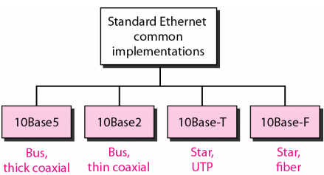
Standard Ethernet

Slide 15
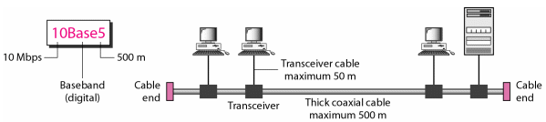
10Base5
Thick Ethernet, Thicknet
Uses bus topology using transceivers (transmitter/receiver)
Max length of coax must not exceed 500m
Maximum of five segments connected with repeaters

Slide 16
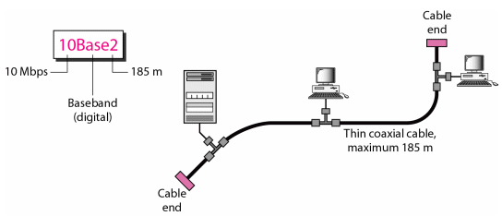
10Base2
802.3a; Thin Ethernet, Thinnet, Cheapernet
Transceiver part of network interface
Less expensive, easy installation, length cannot exceed 185m
Collisions happen in the cable

Slide 17
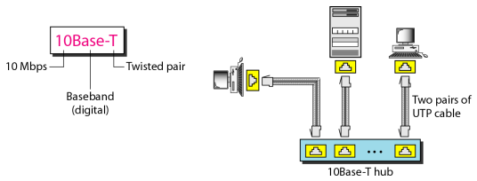
10Base-T
802.3i; Twisted-pair Ethernet
Physical star topology; collisions happen in the hub
Maximum length is 100m

Slide 18
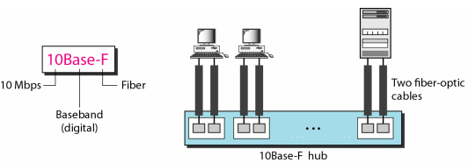
10Base-F
802.3j; Uses star topology to connect stations to hub
Max length is 2km
Used in environments that are electronically noisy

Slide 19
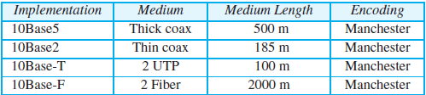
Standard Ethernet
Summary

Slide 20
Bridged Ethernet
Bridge – network device that connects multiple network segments; uses forwarding database to send frames across network segments
Two effects of bridges
  Raise the bandwidth
  Separate collision domains

Slide 21
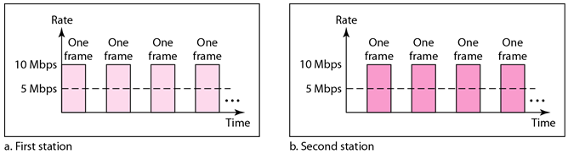
Bridged Ethernet
In unbridged Ethernet, 10Mbps is shared among all stations with a frame to send
If two stations has a lot of frames to send, they alternate in usage; on the average each stations sends 5 Mbps
A bridge divides the network into two or more networks (raising the bandwidth)

Slide 22
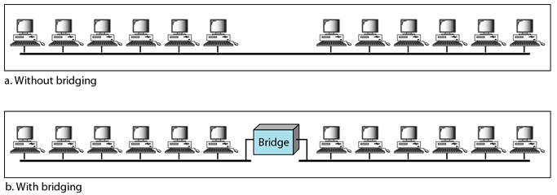
Bridged Ethernet
10 Mbps
12
10 Mbps
10 Mbps
7
7

Slide 23
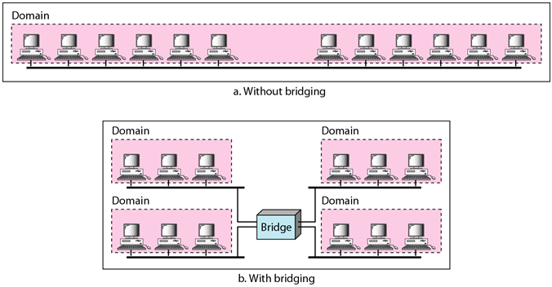
Bridged Ethernet
Collision domains

Slide 24
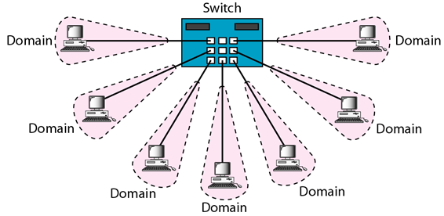
Switched Ethernet
A layer 2 switch is an N-port bridge with additional sophistication that allows faster handling of packets; bandwidth is shared only between the station and the switch

Slide 25
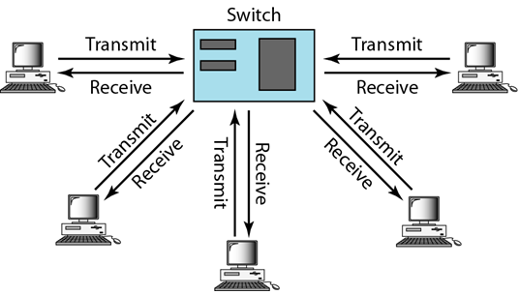
Full Duplex Ethernet
10Base5 and 10Base2 are half-duplex (limitation)
Full duplex mode increases the capacity of each domain from 10 to 20 Mbps
Configuration uses 2 links: one to transmit, one to receive
No need for CSMA/CD

Slide 26
Fast Ethernet
802.3u
Designed to compete with FDDI
Backwards compatible with Standard Ethernet
100 Mbps
Goals
  Upgrade the data rate to 100 Mbps
  Make it compatible with Standard Ethernet
  Keep the same 48-bit address
  Keep the same frame format
  Keep the same minimum and maximum frame lengths

Slide 27
Fast Ethernet
Keep the MAC sublayer untouched
Only supports star topology
CSMA/CD for full-duplex
Autonegotiation – allows two devices to negotiate the mode or data rate of operation
  Allow incompatible devices to connect (10 Mbps and 100Mbps)
  Allow device to have multiple capabilities
  Allow a station to check hub's capabilities

Slide 28
Fast Ethernet
Topology may be point-to-point if only two stations
100Base-TX – two wires CAT 5 UTP
100Base-FX – two wires fiber
100Base-T4 – four wires CAT 3 UTP
Manchester encoding is not suitable (needs 200-Mbaud)

Slide 29
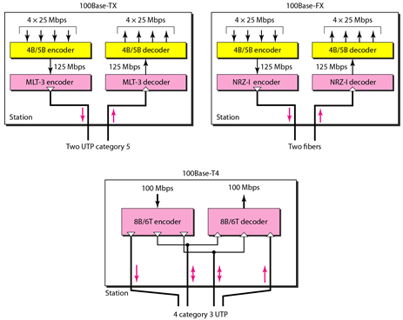
Fast Ethernet

Slide 30

Fast Ethernet
Summary

Slide 31
Gigabit Ethernet
802.3z; GbE, 1GigE, 1000Mbps
Goals
  Upgrade data rate to 1 Gbps
  Make it compatible with Standard or Fast Ethernet
  Use the same 48-bit address
  Use the same frame format
  Keep same minimum and maximum frame lengths
  To support autonegotiation as defined in Fast Ethernet

Slide 32
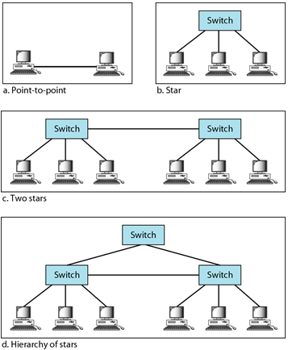
Gigabit Ethernet
Topology

Slide 33
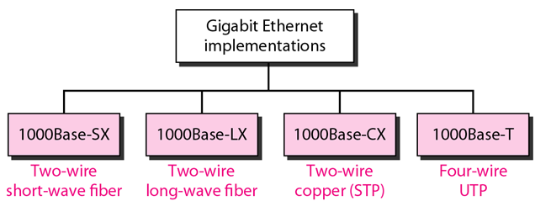
Gigabit Ethernet

Slide 34
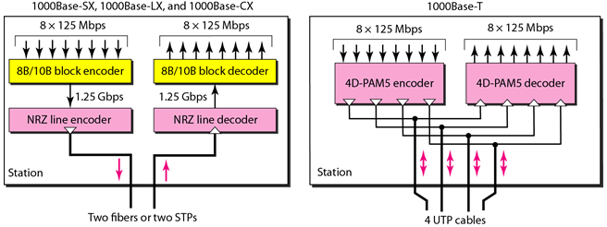
Gigabit Ethernet
Encoding

Slide 35
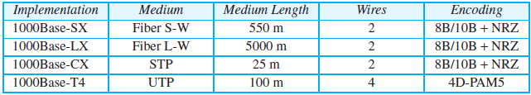
Gigabit Ethernet
Summary

Slide 36
Ten-Gigabit Ethernet
802.3ae; 10GE, 10GbE, 10 GigE
Goals
  Upgrade data rate to 10 Gbps
  Make it compatible with Standard, Fast, and Gigabit Ethernet
  Use the same 48-bit address
  Use the same frame format
  Keep same minimum and maximum frame lengths
  Interconnect LANs to MANs or WANs
  Make Ethernet compatible with Frame Relay and ATM

Slide 37
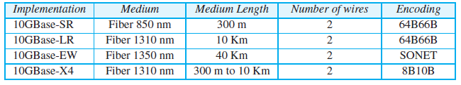
Ten-Gigabit Ethernet
Summary

Slide 38
References
Forouzan, B.A. 2013. Data Communications and Networking, 5th Ed. McGraw-Hill, New York.

